Slide 1
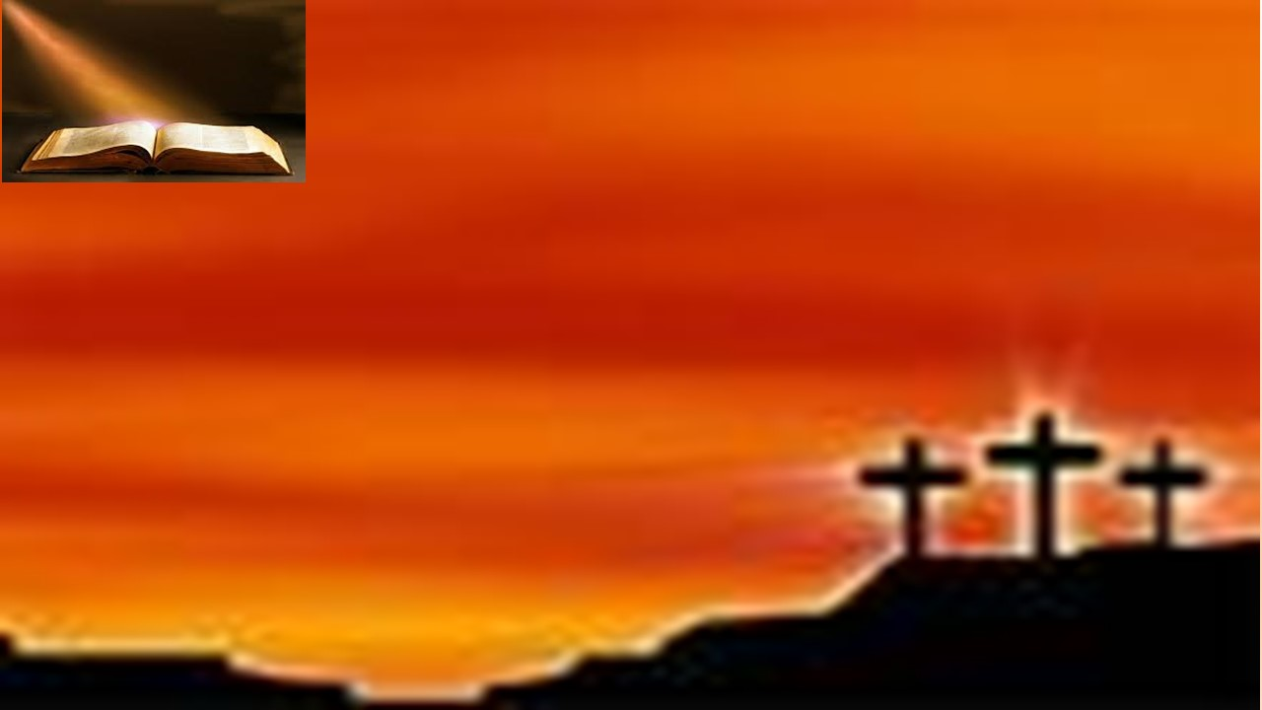
Sermon
证道
Turned Off or Tuned In to the Music?
是关掉，还是聆听属灵的音乐？
Dr. Moon

Slide 2
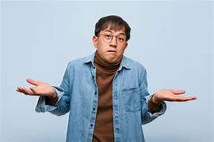
Turned Off or Tuned In to the Music?
是关掉，还是聆听属灵的音乐？
I Peter 3: 8-12
彼得前书 3章 8-12

Slide 3
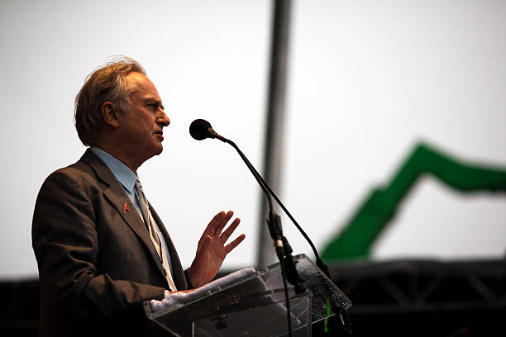
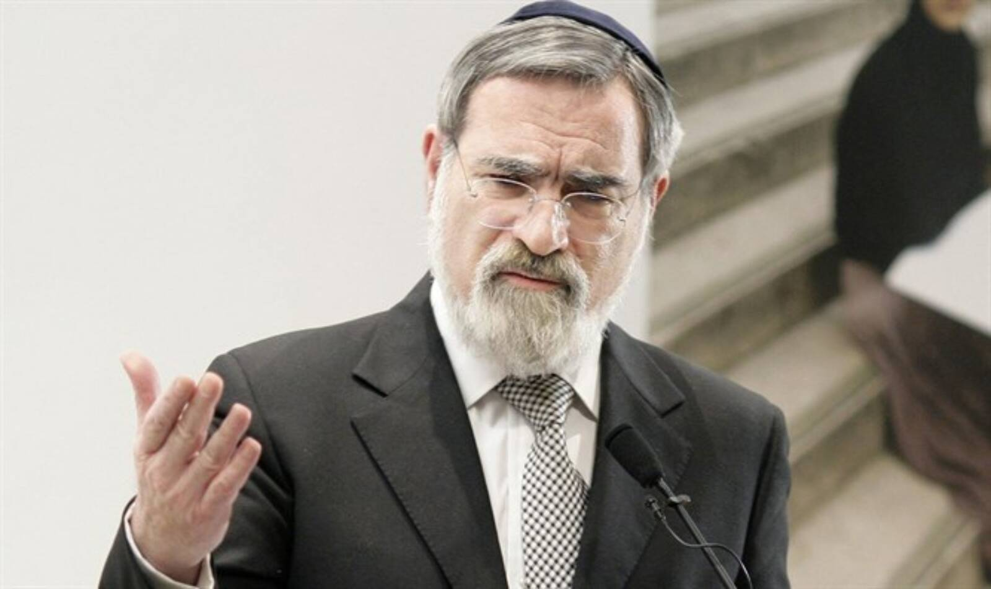
“Richard, you are tone deaf. You can’t hear the music.”
理查德, 你是乐盲，根本听不懂音乐的旋律
Richard Dawkins
理查德·道金斯
Jonathan Sacks
乔纳森·萨克斯
“You are right, Jonathan. I am tone deaf because there is no music.”
“你说得对，乔纳森。我是乐盲，因为根本没有音乐”

Slide 4
“By this all people will know that you are My disciples, if you have love one for another.” John 13:15
“你们若有彼此相爱的心，众人因此就认出你们是我的门徒了”. 约翰福音 13:35
“Finally, all of you, be like-minded, be sympathetic, love one another, be compassionate and humble.” I Peter 3:8
总而言之，你们都要同心，彼此体恤，相爱如弟兄，存慈怜谦卑的心。”— 彼得前书 3:8

Slide 5
Attitudes we need 我们所需要的态度
1.Unity 合一
In essentials unity.
在基本信仰上，要合一；
In non-essentials liberty.
在非基本的事上，要有自由；
In all things charity.
在一切事上，要以爱心行事。
-St. Augustine 圣.奥古斯丁

Slide 6
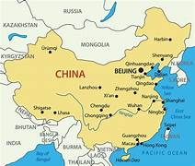
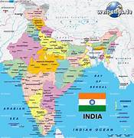
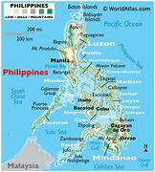
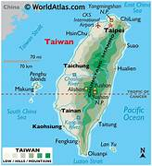
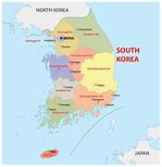
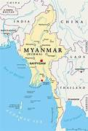
To Know Him and to make Him Known
认识祂，并使别人也认识祂

Slide 7
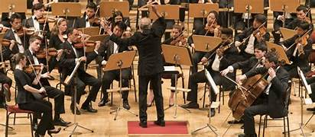
Christians may differ on how things are to be done, but we must agree on what is to be done and why.
基督徒在如何去做事情上可能有不同意见，但我们必须在做什么和为什么去做上达成一致

Slide 8
As believers we must seek
作为信徒，我们必须寻求
  To honor Christ
  荣耀基督
  Win the lost
  拯救失丧者
  Build His church
  建立祂的教会

Slide 9
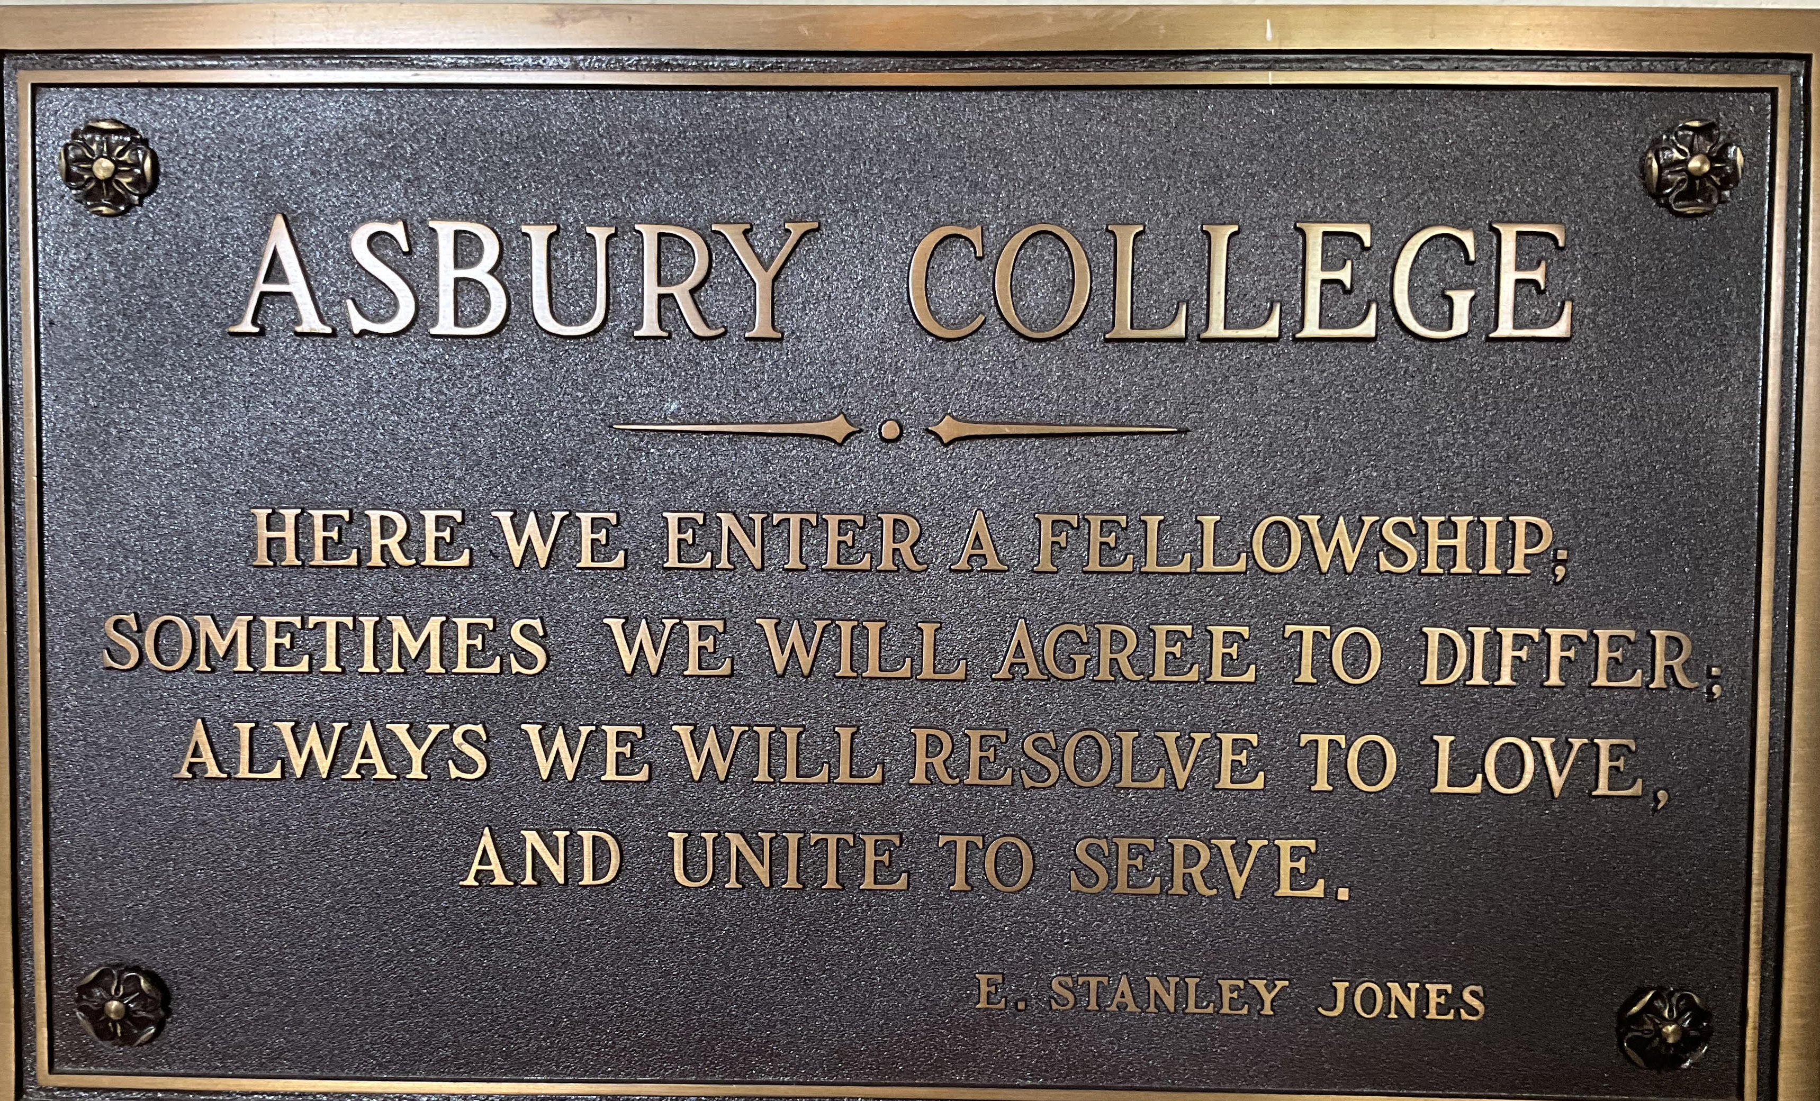
“Here we enter a fellowship. Sometimes we will agree to differ; always we will resolve to love and unite to serve.”
我们在这里进入团契。有时我们会同意彼此有不同意见；但我们总是决心以爱相待，团结一致去服侍

Slide 10
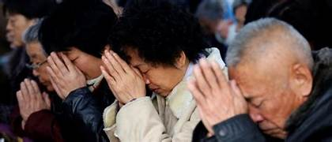
2. Be sympathetic and loving
要体恤和有爱心

Slide 11
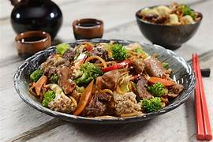
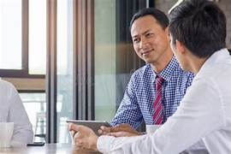
.

Slide 12
Attitudes Christians need
基督徒应有的态度
1. Unity
要合一
2. Sympathy and love
同情与爱心
3. Compassion and humbleness
怜悯与谦卑

Slide 13
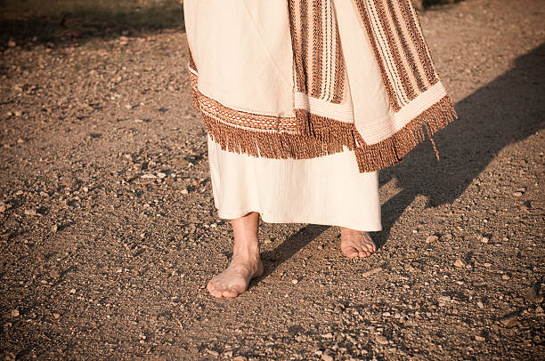
“You are one of us. We will listen to you.”
你是我们中的一员，我们会听你的

Slide 14
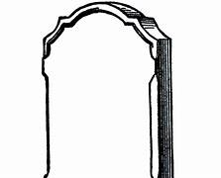

这里安息着查尔斯·戈登的遗体，他在任何时候、任何地方，
将力量给予软弱者，将金钱给予贫穷者，将同情给予受苦者，并将他的心献给上帝。
Here lies the body of Charles Gordon, who at all times and everywhere gave his strength to the weak, his money to the poor, his sympathy to the suffering and his heart to God.”

Slide 15
II. Actions Christians need to pursue
基督徒应有的行动
1. Control our speech 控制我们的言语
“…keep your tongue from evil and your lips from deceitful speech.” I Peter 3: 10
要禁止舌头不出恶言，嘴唇不说诡诈的话。”
—彼得前书 3:10

Slide 16
^{5 ”}the tongue is a small part of the body, but it makes great boasts. Consider what a great forest is set on fire by a small spark. ⁶ The tongue also is a fire, a world of evil among the parts of the body. It corrupts the whole body, sets the whole course of one’s life on fire, and is itself set on fire by hell.” James 3:5-6
“舌头虽然是个小肢体，却能说大话。看哪，最小的火能点着最大的树林。舌头就是火，在我们百体中，舌头是个罪恶的世界，能污秽全身，也能把人生的轮子点起来，并且是从地狱里点着的。”——雅各书 3:5-6

Slide 17

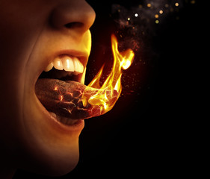
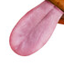
Sticks and stones will break my bones, but words will break my heart.
棍棒和石头可以打断我的骨头，但言语却能伤透我的心。

Slide 18
II. Actions Christians need to pursue 基督徒应有的行动
  1. Control our speech
  控制我们的言语
  2. Pursue the divine path
  追求神圣的道路

Slide 19
“not to return evil for evil, insult for insult. On the contrary, repay evil with blessing….” I Peter 3: 9
“不以恶报恶，以辱骂还辱骂，反倒要祝福…”—彼得前书 3:9

Slide 20
Pursue the divine path 追随属神的道路
1. We can give evil for good. This is a satanic path.
我们以恶报善，这是撒但的道路
2. We can give good for good or evil for evil. This is the worldly path.
我们以善报善，以恶报恶，这是属世的道路。
3. We can give good for evil. This is the divine path.
我们以善报恶，这就是神圣的道路

Slide 21
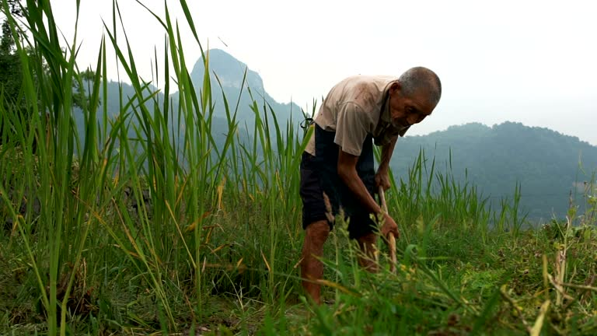
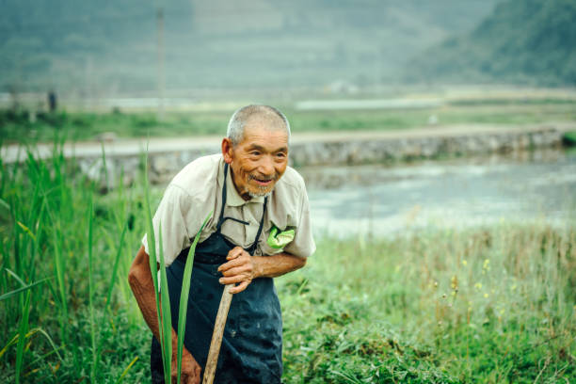
Pursue the divine path by repaying evil with blessing.
追求神圣的道路以祝福回应恶

Slide 22
II. Actions Christians need to pursue
基督徒应有的行动
  1. Control our speech
  控制我们的言语
  2. Pursue the divine path
  追求神圣的道路
  3. Seek and pursue peace
      追求并维护和平

Slide 23

“We must turn from evil and do good; we must seek peace and pursue it.” I Peter 3: 11
我们也要离恶行善，寻求和睦，一心追赶。彼得前书 3:11
Friend 朋友
Tim 蒂姆

Slide 24

Bob 鲍勃
Friend 朋友

Slide 25

“We must turn from evil and do good; we must seek peace and pursue it.” I Peter 3: 11
我们也要离恶行善，寻求和睦，一心追赶。彼得前书 3:11
Friend 朋友
Tim 蒂姆

Slide 26

“Blessed are the peacemakers for they will be called the children of God.” Matthew 5: 9
“使人和睦的人有福了，因为他们必称为神的儿子” 马太 5：9

Slide 27
If we as Christians show our love
如果我们作为基督徒展现我们的爱是通过
By our attitudes
我们的态度
By our actions
我们的行动
What is the result?
结果是什么呢？

Slide 28
“Whoever would 1. love life and 2. see good days must keep their tongue from evil …and do good; they must seek peace and pursue it. 3. For the eyes of the Lord are on the righteous and 4. His ears are attentive to their prayer, but the face of the Lord is against those who do evil.” I Peter 3: 10-12
“人若 1.爱生命，2. 愿享美福，须要禁止舌头不出恶言，嘴唇不说诡诈的话； 也要离恶行善，寻求和睦，一心追赶。3. 因为主的眼看顾义人，4.主的耳听他们的祈祷；唯有行恶的人，主向他们变脸。。”——彼得前书 3:10-12

Slide 29
The blessings we can receive as we love
当我们以爱心生活时，我们可以得到的祝福包括：
1. We can have a life we love.
我们可以拥有自己喜爱的生活。
2. We will enjoy good days.
我们将享受美好时光
3. We will enjoy God‘s approval.
我们将享受神的喜悦与认可
4. Our prayers will be heard.
我们的祷告必蒙垂听

Slide 30
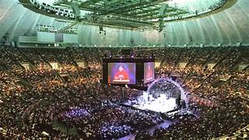

Slide 31
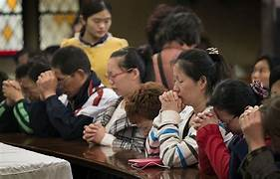
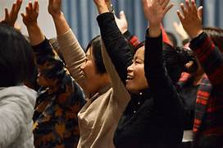
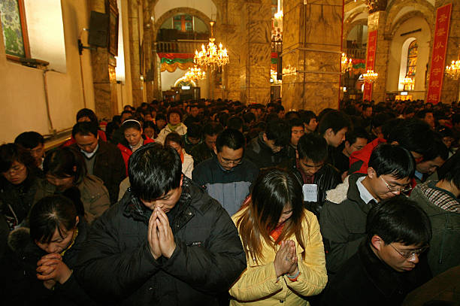

Slide 33
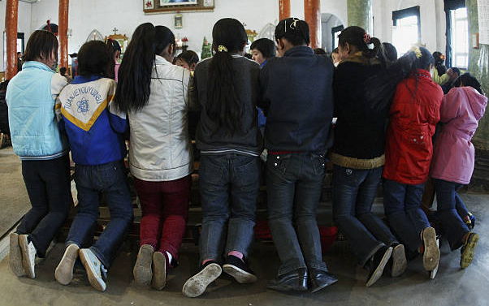

Slide 34
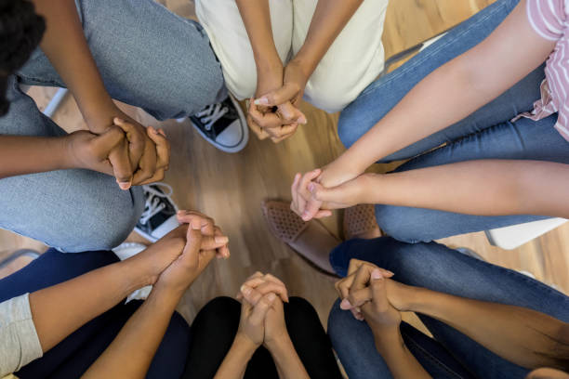
“that all of them may be one, Father, just as You are in Me and I am in You. May they also be in us so that the world may believe that You have sent Me.” John 17:21
“愿他们都合而为一，父啊，正如你在我里面，我也在你里面；愿他们也在我们里面，使世人可以信你差了我来。” ——约翰福音 17:21

Slide 35
We Are One In The Spirit
We Are One In The Lord [2]
And We Pray That All Unity
May One Day Be Restored
And They’ll Know We Are
Christians By Our Love,
By Our Love;
Yes, They’ll Know We Are Christians By Our Love!
我们在圣灵里合一，
我们在主里合一，[2]
同心求圣灵引导，
使我们众人合一。
因着爱世人知道我们是基督徒，
是的，世人会因我们的爱知道我们是基督徒！

Slide 36
We Will Walk With Each Other
We Will Walk Hand In Hand [2]
And Together We Will Spread The News,
That God Is In Our Land
And They’ll Know We Are Christians
By Our Love, By Our Love;
Yes, They’ll Know We Are Christians By Our Love!
我们将彼此同行，
我们将手牵手同行，[2]
我们将一同传播福音，
告诉世人神就在我们中间，
因着爱世人知道我们是基督徒，
是的，世人会因我们的爱知道我们是基督徒！

Slide 37
In the night of his betrayal, Jesus took bread, and when He had given thanks, He broke it and gave it to His disciples, saying, “Take, eat; this is My body which is given for you; do this in remembrance of Me. In like manner, after supper He took the cup, and when He had given thanks, He gave it to them, saying, “Drink of this, all of you, for this is My blood of the New Testament, which is shed for you and for many, for the forgiveness of sins; do this as often as you drink it, in remembrance of Me. Amen
就是主耶稣被卖的那一夜，拿起饼来， 祝谢了，就掰开，说：“这是我的身体，为你们舍的。你们应当如此行，为的是记念我。” 饭后，也照样拿起杯来，说：“这杯是用我的血所立的新约。你们每逢喝的时候，要如此行，为的是记念我。 阿们。
。

Slide 38
The body of our Lord Jesus Christ, which was given for you, preserve your soul and body onto everlasting life. Take and eat this in remembrance that Christ died for you, and feed upon Him in your heart, by faith with thanksgiving.
我们主耶稣基督的身体，为你舍了，愿祂保守你的灵魂和身体，直到永生。请领受这饼，纪念基督为你而死，并在你心里，凭着信心和感恩之心来领受祂。

Slide 39
The blood of our Lord Jesus Christ, which was shed for you, preserve your soul and body onto everlasting life. Drink this in remembrance that Christ blood was shed for you, and be thankful.
我们主耶稣基督的宝血，为你流出，愿祂保守你的灵魂和身体，直到永生。
请喝这杯，纪念基督为你流血救赎，并怀着感恩的心领受。

Slide 40
PRAYER 禱告
Congregation prays
May the peace of God which passes all understanding, keep your hearts and minds in the knowledge and love of God, and of his Son, Jesus Christ, our Lord. And may the blessing of God Almighty, the Father, the Son, and Holy Spirit, be Yours now and forever more. Amen.
願上帝賜你們出人意外的平安，保守你們的心懷意念，永遠信服敬愛上帝和上帝的聖子我主耶穌基督。又願聖父、聖子、聖靈、三位一體的主，常在你們眾人中間。阿們。

Slide 41
“that all of them may be one, Father, just as You are in Me and I am in You. May they also be in us so that the world may believe that You have sent Me.” John 17:21
“愿他们都合而为一，父啊，正如你在我里面，我也在你里面；愿他们也在我们里面，使世人可以信你差了我来。” ——约翰福音 17:21

